Slide 1
Monster Design
Time to taste Blueprint

Slide 2
Session 2 13-14 Goals
Audio Perception
Building Investigation States
Testing

Slide 3
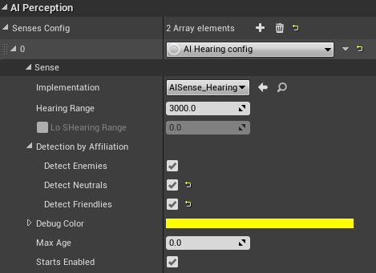
Audio Perception
To begin the Audio Adventure make sure your MonsterBaseCharacter has an AISense setup for Hearing.
There isn’t any special value required to setup the Hearing Range as such, tweak to your hearts content.
Make sure you enable all the Detection by Affiliation Bools.

Slide 4
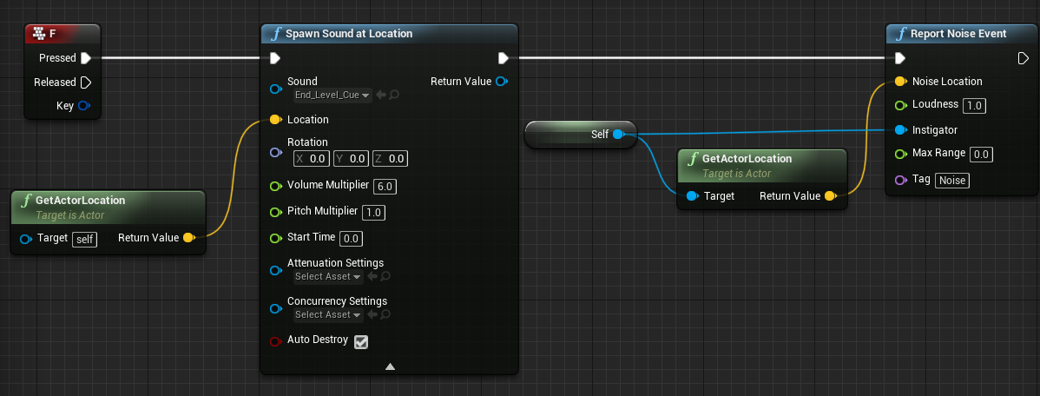
How do we report Audio to the AI?
In order for the AI to hear the player / any actor you need to make use of a Report Noise Event node. I’ve set this up already in the BasePlayerCharacter, try pressing “F” in game…

Slide 5
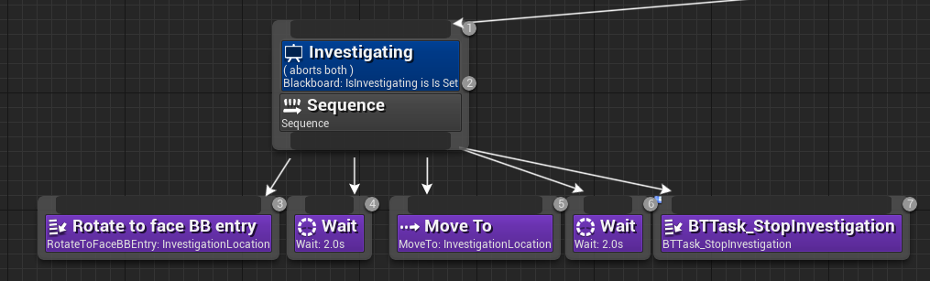
What should the AI do when it’s heard the player?
Thoughts?
Maybe something like this?

Slide 6
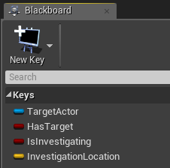
Audio Behaviour Trees
To start the audio adventure create 2 new keys in the Blackboard section of the Behaviour Tree.
Create the following Keys;
IsInvestigating :- KeyType :- Bool
InvestigationLocation :- KeyType :- Vector

Slide 7
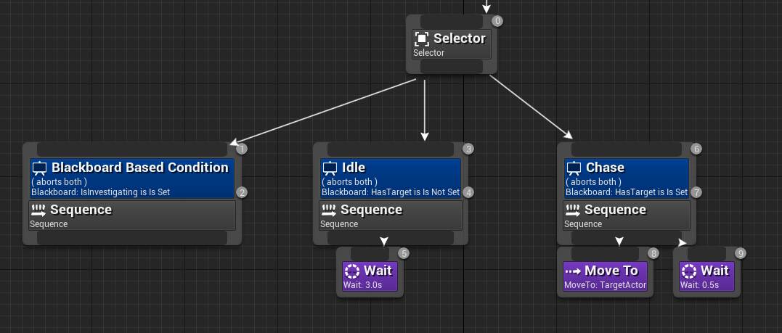
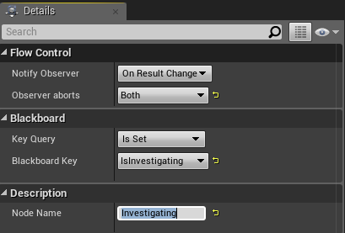
Audio Behaviour Trees
Create a new Sequence before the Idle Sequence.
Add a Blackboard Decorator and setup it’s details are per below.
The Blackboard will check use of the IsInvestigating Bool.

Slide 8
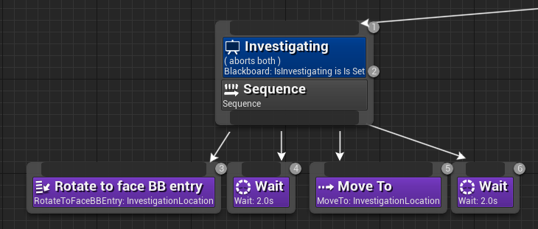
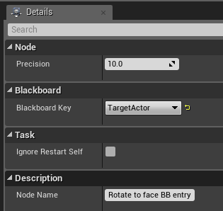
Audio Behaviour Trees
Add the following 4 nodes underneath the Sequence for Investigating.
These nodes are default UE4 nodes. For the Rotate to face node and the Move to node set them to utilise the InvestigationLocation.

Slide 9
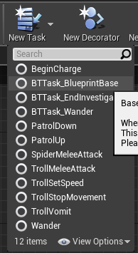

Audio Behaviour Trees
Create a new Task.
Use the Content Browser to rename the task BTTask_StopInvestigation.
This Task will be used to reset the Blackboard variables after the AI stops investigating an Audio Source.

Slide 10
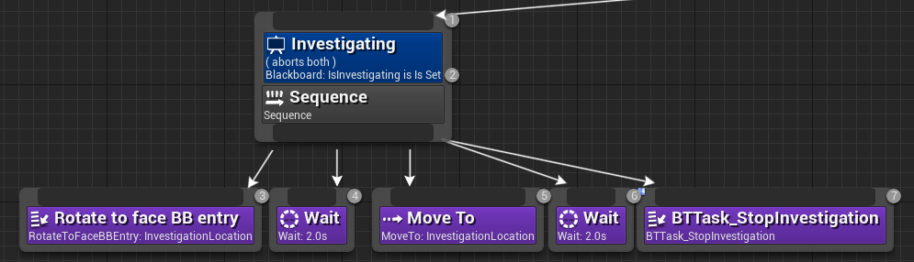
Audio Behaviour Trees
Add the custom StopInvestigation task to complete Sequence.
Upon hearing a noise the AI will now look at the location of the sound and eventually move toward it before pausing and finalising the investigation.

Slide 11
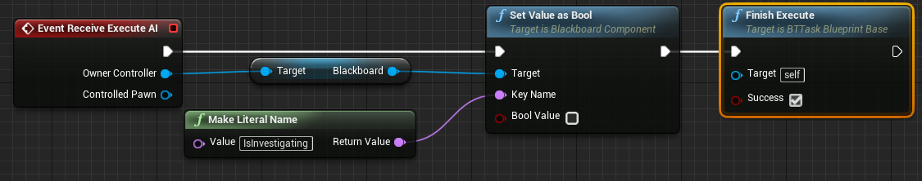
BTTask_StopInvestigation
Setup the following nodes inside of BTTask_StopInvestigation
This will change the Blackboard bool for IsInvestigating.
Make sure to include the FinishExecute.

Slide 12
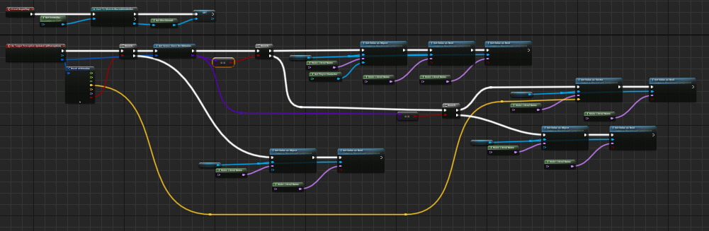
Back to MonsterBaseCharacter
To add in the audio functionality into the detection logic we need to add the blue highlighted areas to MonsterBaseCharacter.

Slide 13
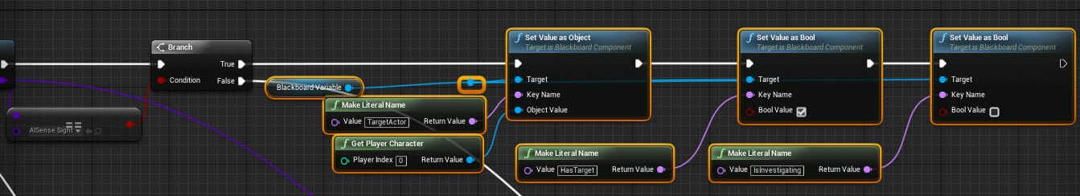
Back to MonsterBaseCharacter
The first additional node needs to go right after the Has Target section of the graph.
Here we want to set IsInvestigating to false so that if the AI sees a player they will stop investigating an audio source and chase the player.

Slide 14
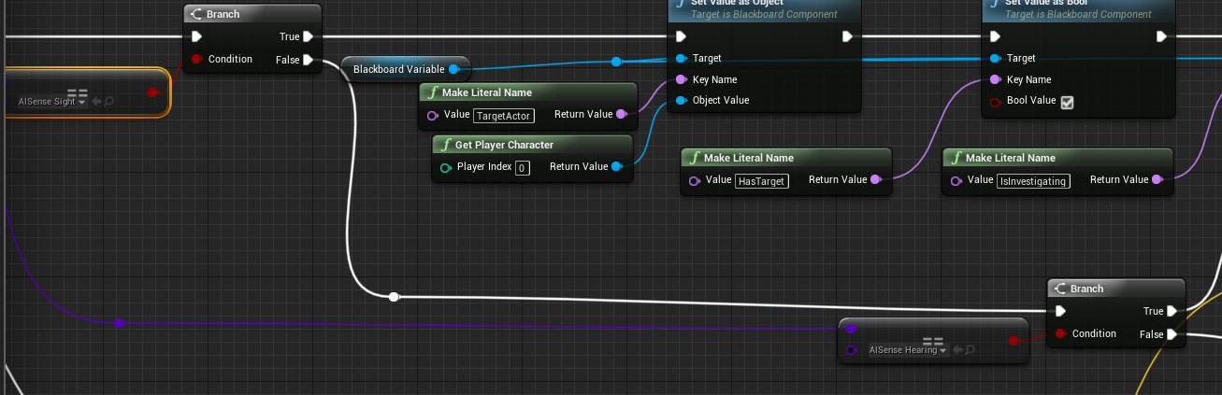
Back to MonsterBaseCharacter
Out of the False Branch following the Sight Check add another Sense check this time for AISense_Hearing.
The idea here is that if we get a successful sense check but it’s not a sight sense we check to see if its hearing based.

Slide 15
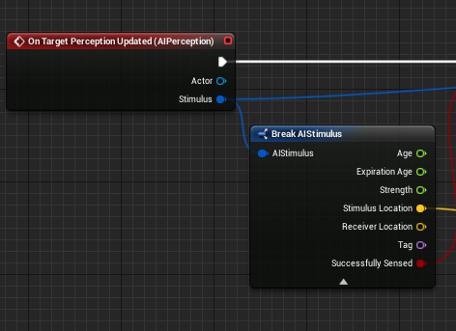
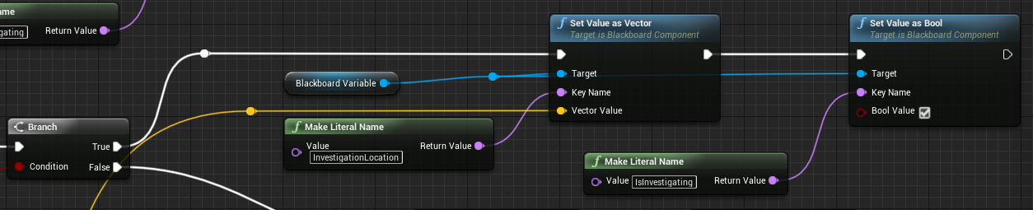
Back to MonsterBaseCharacter
If the Hearing check is true, set the Investigation and IsInvestigating Blackboard Variables.
The variables for InvestigationLocation comes from the original BreakAIStimulus node that outputs a Stimulus Location.

Slide 16
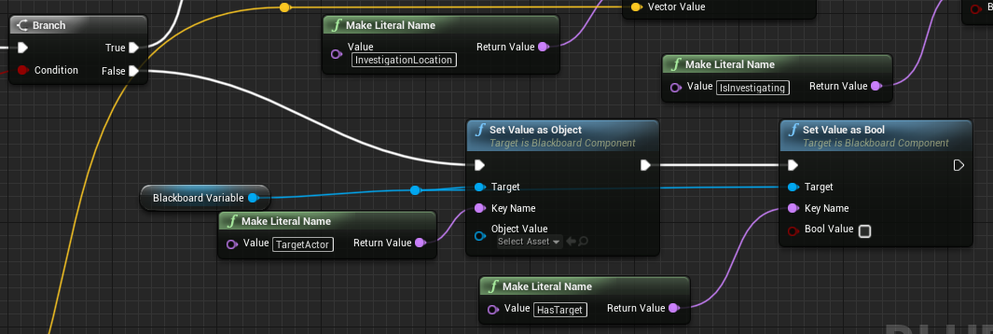
Back to MonsterBaseCharacter
The False of the AISense_Hearing branch is set to clear out any target Blackboard bools.
It’s unlikely that these will have much effect, but sometimes on False Branches it’s worth resetting Blackboard values to avoid conflicts.

Slide 17
Testing!
Try out what we’ve created.
Stand away from the AI and press F.
See if the AI swaps between investigating and chasing if they see you on the way to the Audio stimulus.

Slide 18
AI Animations
Today isn’t really focused on animations, but I thought it might be interesting to add show a nice quick way of communicating with Animation Blueprints from within a Behaviour Tree.

Slide 19
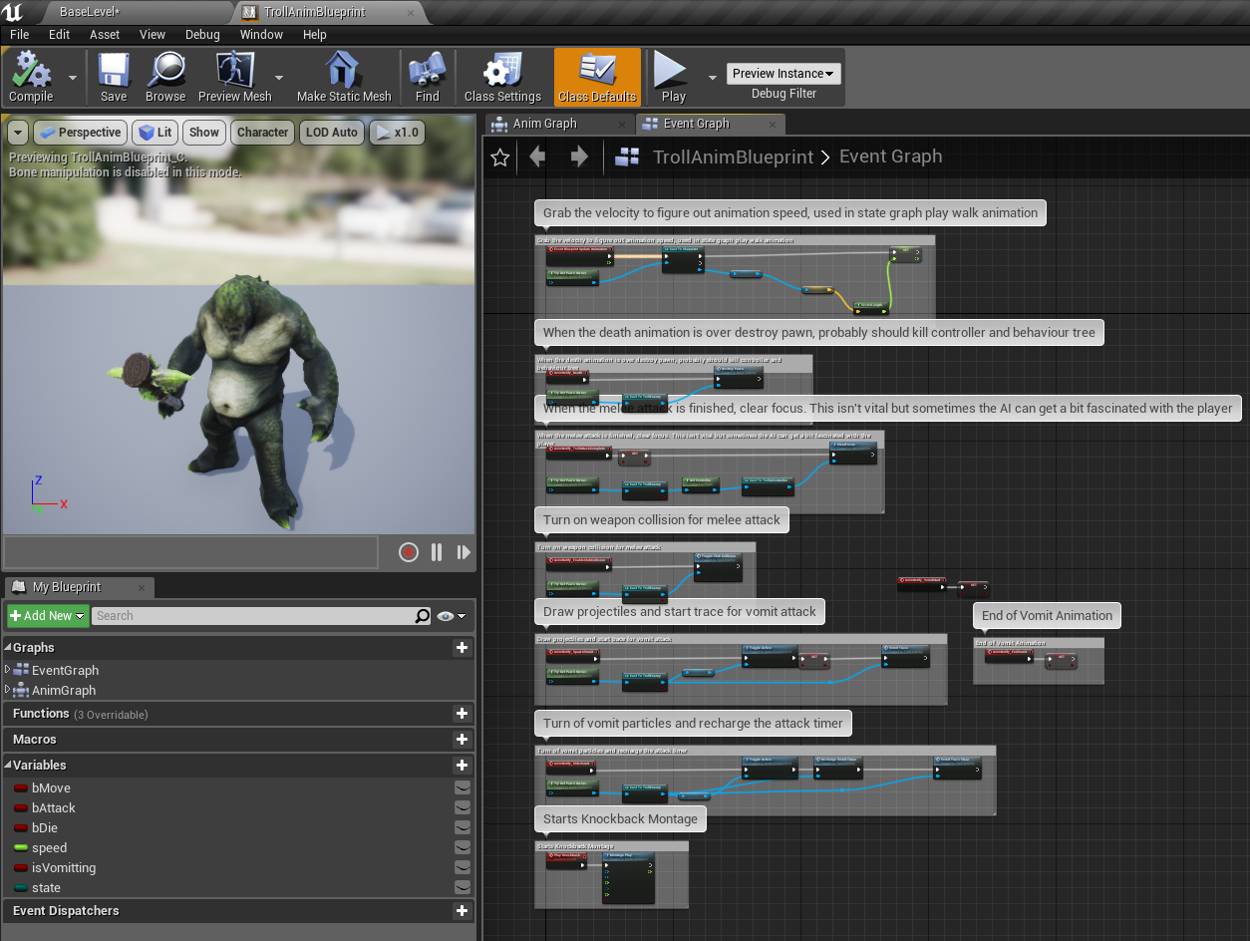
AI Animations
Here is the TrollAnimationBlueprint.
The Event Graph has several completed Events to help figure out the Trolls Speed, control the ending of animation and attacks etc.

Slide 20
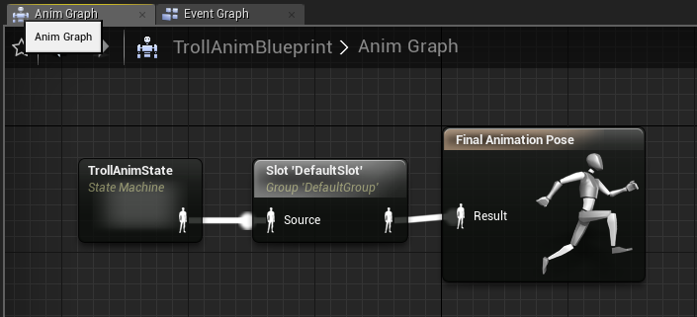
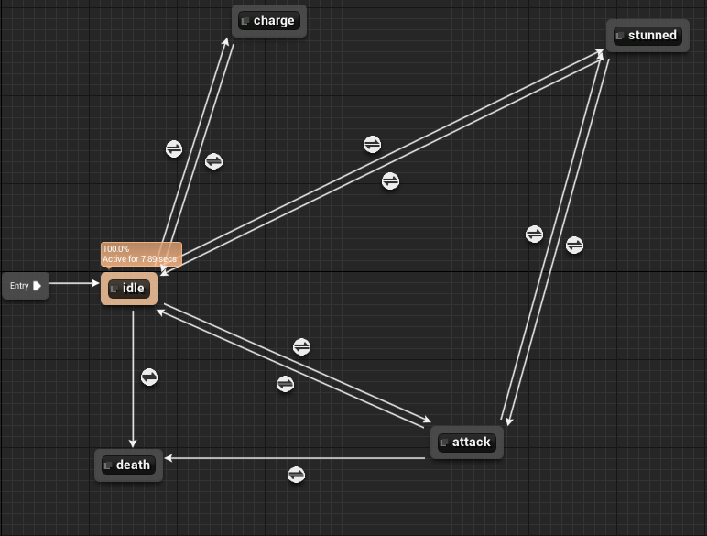
AI Animations
Inside of the AnimationBlueprint there is also the AnimGraph.
The AnimGraph is a StateMachine. To play animations we need to override the animation graph, you can do this by altering the State Machine, Play a Slot Animation or by Playing a Montage.
To use Slot Animations the Anim Graph needs nodes like prior to the Final Animation Pose (see the end of the slides for some videos).

Slide 21
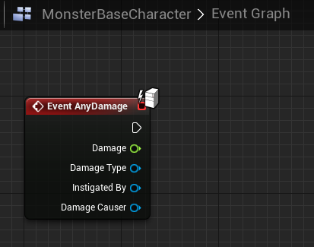
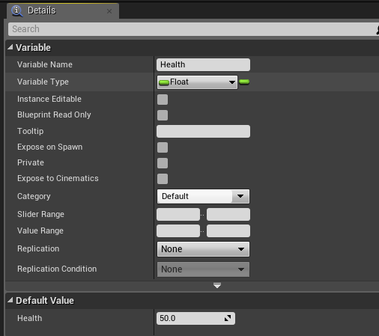
AI Animations :- Death
To play the death animation create an event called “AnyDamage” within the MonsterBaseCharacter Blueprint.
Also create a Health variable, I’ve set it to 50 (feel free to balance this as you wish).

Slide 22
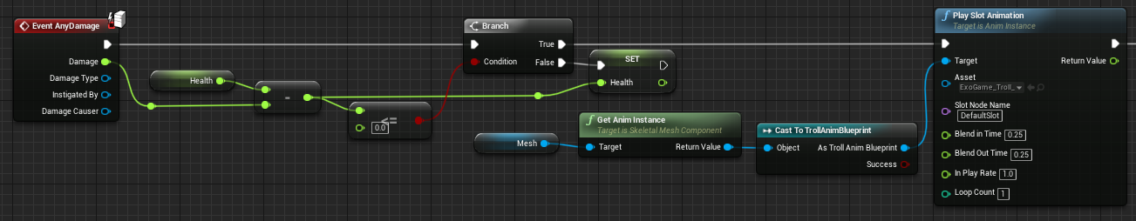
AI Animations :- Death
Add the following nodes to Event Any Damage.
The logic checks the Health of the character, if it’s less than or equal to 0 after receiving damage then the Troll Death animation is played using the DefaultSlot.

Slide 23
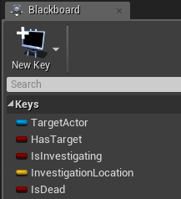
AI Animations
Go back to the Blackboard section of the BehaviourTree.
Add a new key called IsDead.
We will use this to cancel the BehaviourTree flow if the character is reported as dead.
This will be used to avoid floaty dead AI chasing the player.

Slide 24
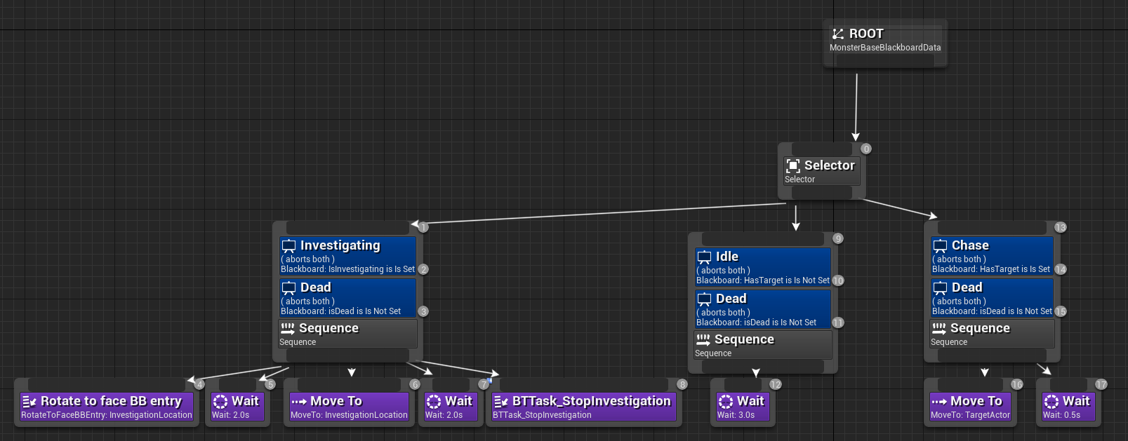
AI Animations
Now add a new Blackboard Decorator to all the Sequences.
Make sure to Abort both on all of Blackboards using the IsDead query.

Slide 25
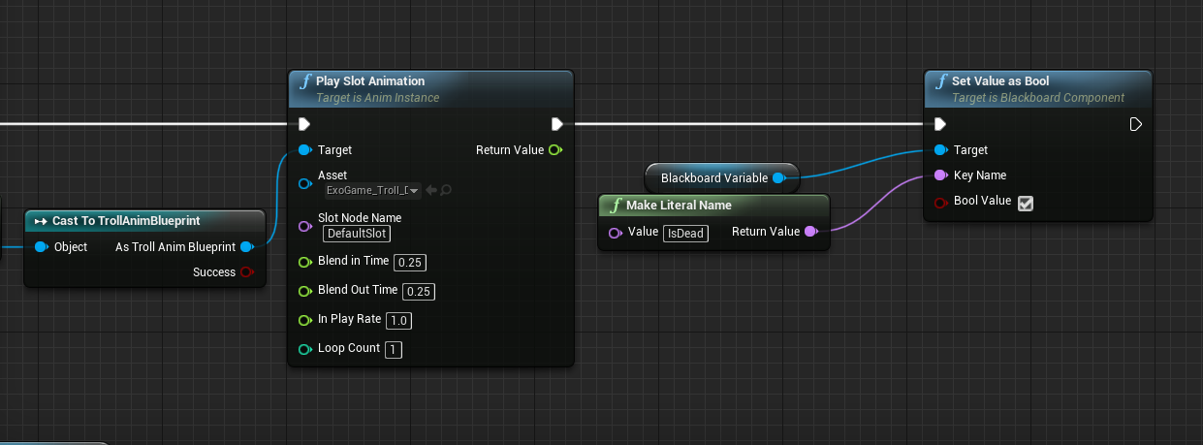
AI Animations
Lastly go back to the MonsterBaseCharacter Blueprint, after the execution of the Slot Animation connect in a Set Value as Bool node that sets the IsDead Blackboard Variable to true.

Slide 26
AI Animations
Test the AI.
You should now be able to shoot the AI and see the death animation sequence.
That’s your lot for today, use the rest of the time in the labs to experiment and have fun.
Happy AI and Monster Designing!

Slide 27
References
https://www.youtube.com/watch?v=sbV7MT1nn28
https://www.youtube.com/watch?v=YVC-DL9Ibf0

